Slide 1
CPSC 481 Final presentation
Ekhonmu Egbase, Lucy Ouyang,
Esther Thompson, Nami Marwah

Slide 2
Context
We are Globe Trekker, a local travel company based in calgary that is building a web application for tourists coming to Calgary.
Globe Trekker offers features like destination and event recommendations, itinerary planning, price comparisons for different activities, and access to local amenities and emergency services.
Globe Trekker is designed for primarily travellers who have not been to Calgary before, or users that are looking to experience new things in the city.
With the growth of mobile and digital solutions, the company seeks to appeal to tech-savvy tourists by offering a digital platform that enables users to discover Calgary's landmarks, restaurants, and events.

Slide 3
Design Thinking
We wanted only users of the app to be able to navigate through the webpage
Access to information we thought was necessary such as “map” and “emergency” and “weather” are always persistent on the screen, no matter where the user navigates to.
Ease of use was a big factor. We wanted to reduce the amount of redirects that the user had to be taken through, so we restricted most of the user functionality to popup modals. There are really only 3 “pages” that the user interacts with through the entire application.

Slide 4
Design Progression
Filter Button Change: Relocated from the main page to improve usability based on team discussion.
Enhanced Event Navigation: Created a new page for users to explore larger collections by clicking on individual event cards.
Improved User Focus: Darkened backgrounds to direct attention to key areas following user actions.
Streamlined Features: Removed or simplified features like search, transit, and notifications to prioritize simplicity and clarity.

Slide 5
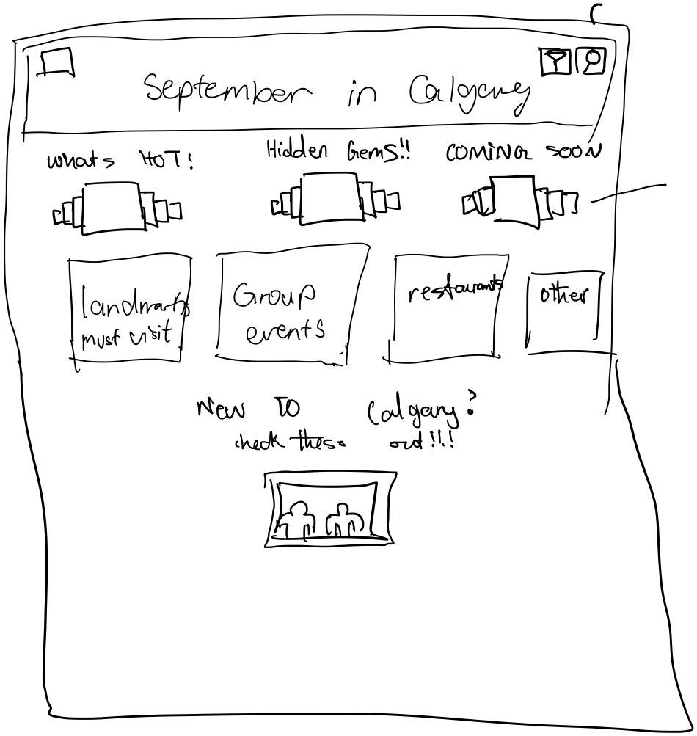
Design Progression
One main aspect of our design was that we wanted all of the cards to be visible to the user on first open.
This was one of our first design ideas, where each card exists in “sub categories” where the user can click and swipe to gain more information.
The issue with this was the user action would already be numerous for functionality that can be handled in one action. There was also a tendency to overcrowd the main interface.

Slide 6
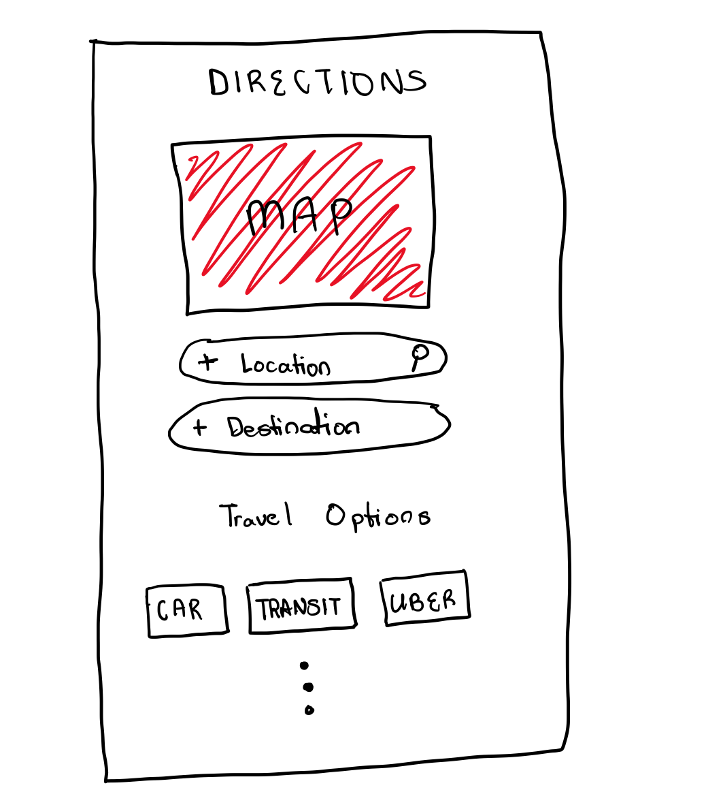
Design Progression
Another aspect of our initial design was the complexity of the map functionality. Initially we desired features that would allow the user to put in their location and destination into the site.
The issue with this was the design was meant for users that are new to calgary, so the odds that they know exactly where they’re going is not as high, until the specific activity has been selected.

Slide 7
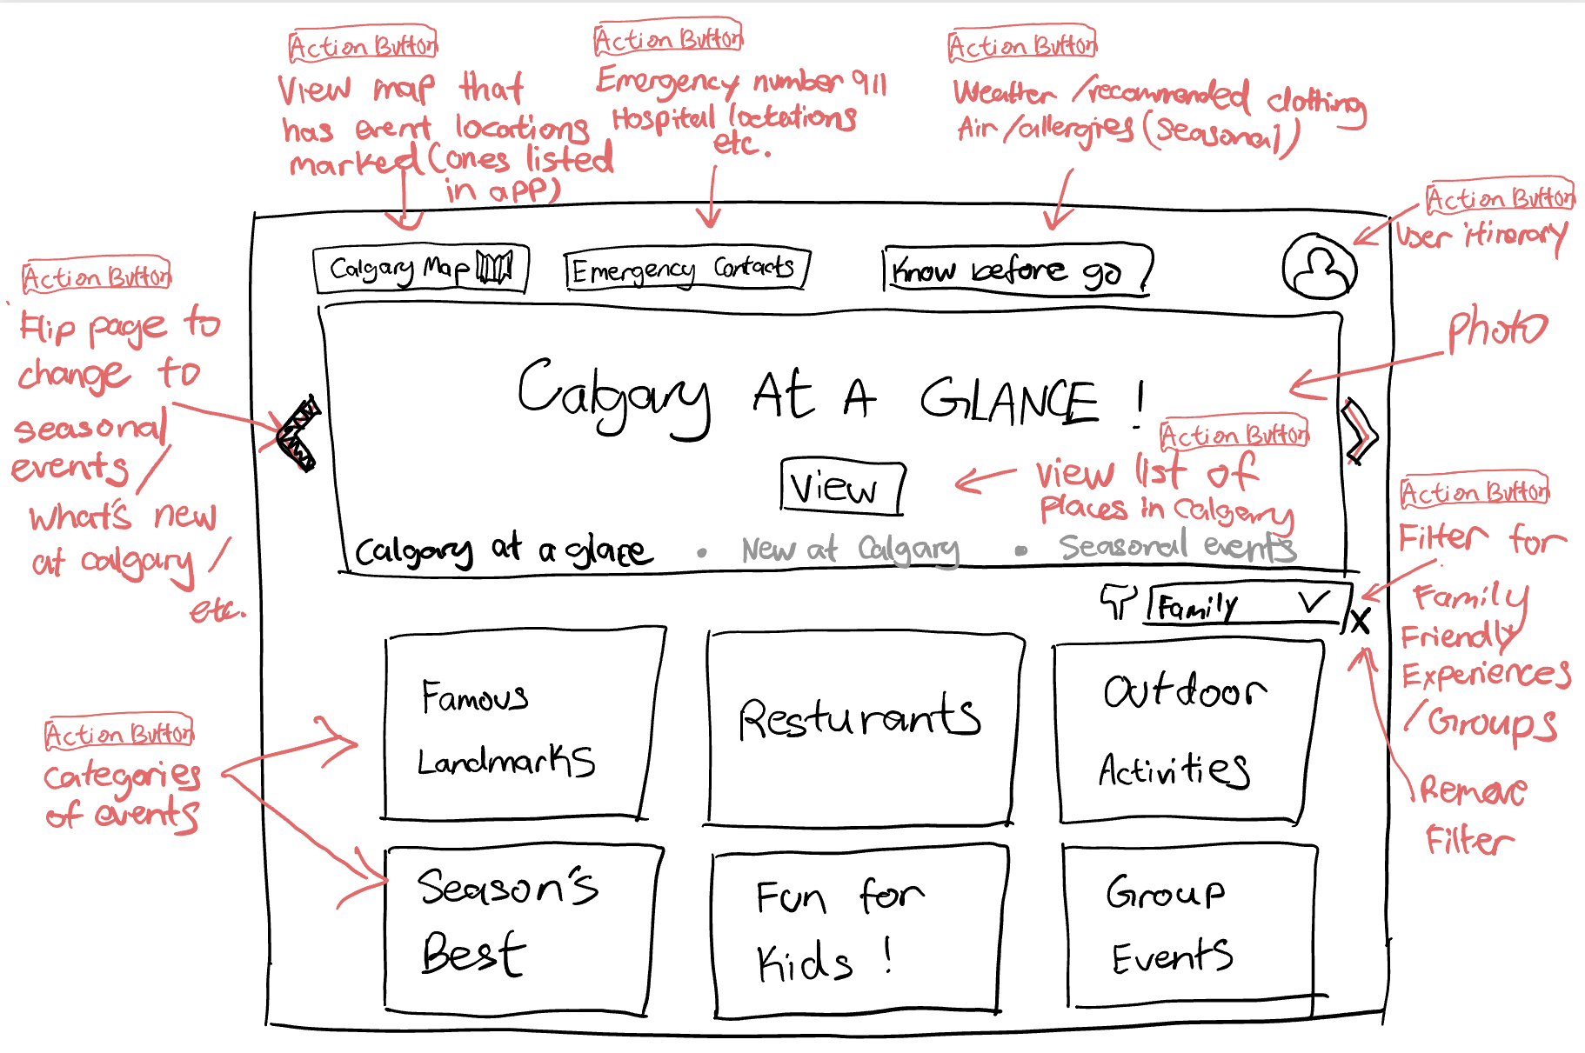
Design Progression
As we deliberated on the design of the homepage, we came to a consensus that the homepage should have all the cards separated in blocks, each with their own corresponding action that redirects them to a page with the relevant information.
Removal of the search button reduces additional functionality that new visitors to calgary have to interact with

Slide 8
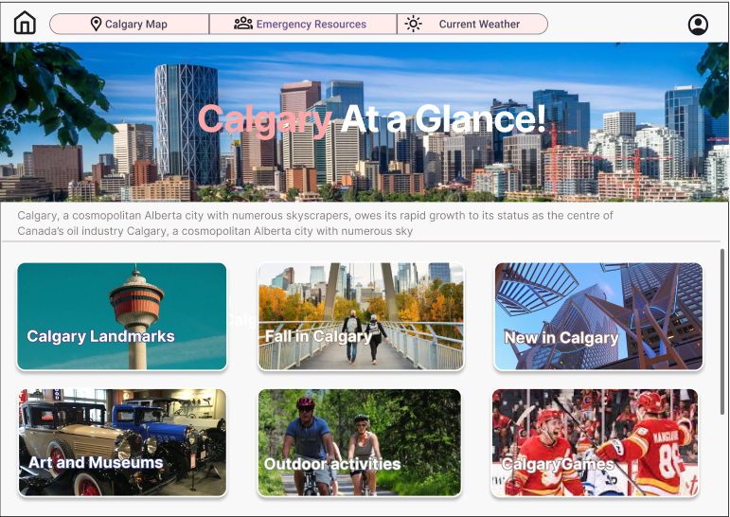
Design Progression
Our final design for the homepage took the main aspects of our recent prototype. We removed the “view” button because we thought it was a bit redundant to the design, since the other clickable cards don’t have button prompts as well.

Slide 9
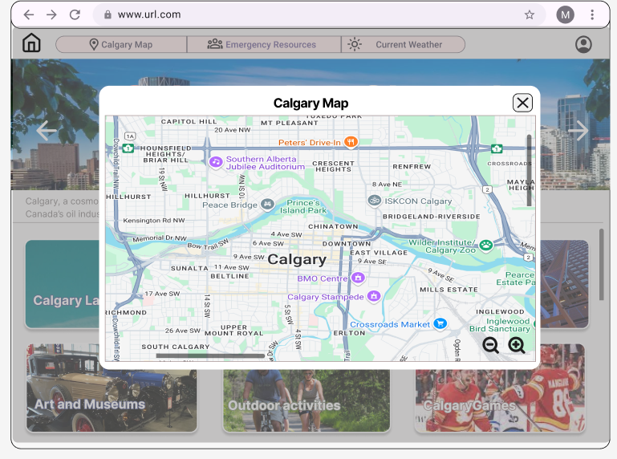
Design Progression
We also went with our toned down version of the popup functionality. So now most of the actionable items raise the corresponding popup modals for the user to interact with. Like the map as shown on the left.

Slide 10

Demonstration Video

Slide 11
Live Demo
https://lcylight.github.io/calgary-app/

Slide 12
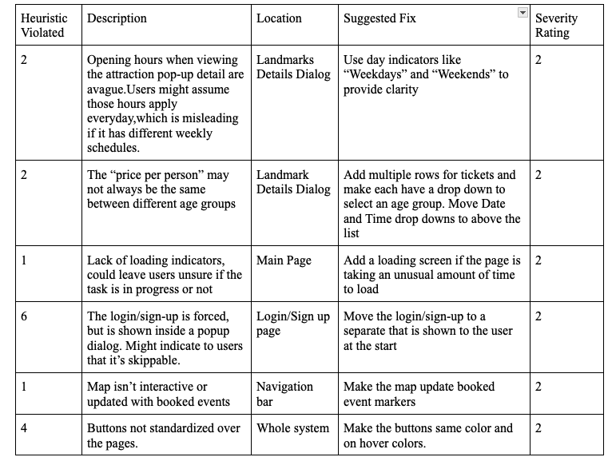
Evaluation

Slide 13
Reflection & Final Thoughts
Did prototype succeed?
Our prototype was largely successful in meeting its goals, particularly in translating key features and functionality from initial concepts into a tangible product. While the high fidelity designs laid a solid foundation, some elements needed to be adapted based on user feedback, feasibility, or new insights during development.
What issues encountered?
During prototyping, we faced challenges like ensuring functionality, aligning styles with our design vision, and improving workflow efficiency. Managing branches effectively reduced merge conflicts and streamlined teamwork. Technical hurdles, such as design choices, time constraints, and edge-case testing, highlighted the importance of clear communication, iterative testing, and flexibility.

Slide 14
Improvements?
Key improvements were made to enhance usability and user experience. Navigation was streamlined for a more efficient browsing process, while essential information was added to support better decision-making. The user interface was simplified to reduce confusion, and a confirmation step was introduced during critical actions to minimize errors and boost user confidence. These changes improved overall usability and created a smoother user interaction with the system.
What did we learn?
Heuristic evaluation and user feedback underscored the value of iterative testing in enhancing website design and usability. Consistent layouts, effective collaboration, and version control reduced inefficiencies. We learned that small changes can significantly impact usability and gained insights into the user-centered design process. Moving forward, we’ll focus on comprehensive user testing, feature refinement, and exploring advanced features like improved navigation and customization—prioritizing flexibility, detail, and user needs.

Slide 15
Thank You
Questions?

